Slide 1




Social Media Insights
01 Nov 25
30 Nov 25
-
Spinal Care Clinics
Spinal Care Clinics - Brentwoo...
spinalcarebrentwood

Slide 2



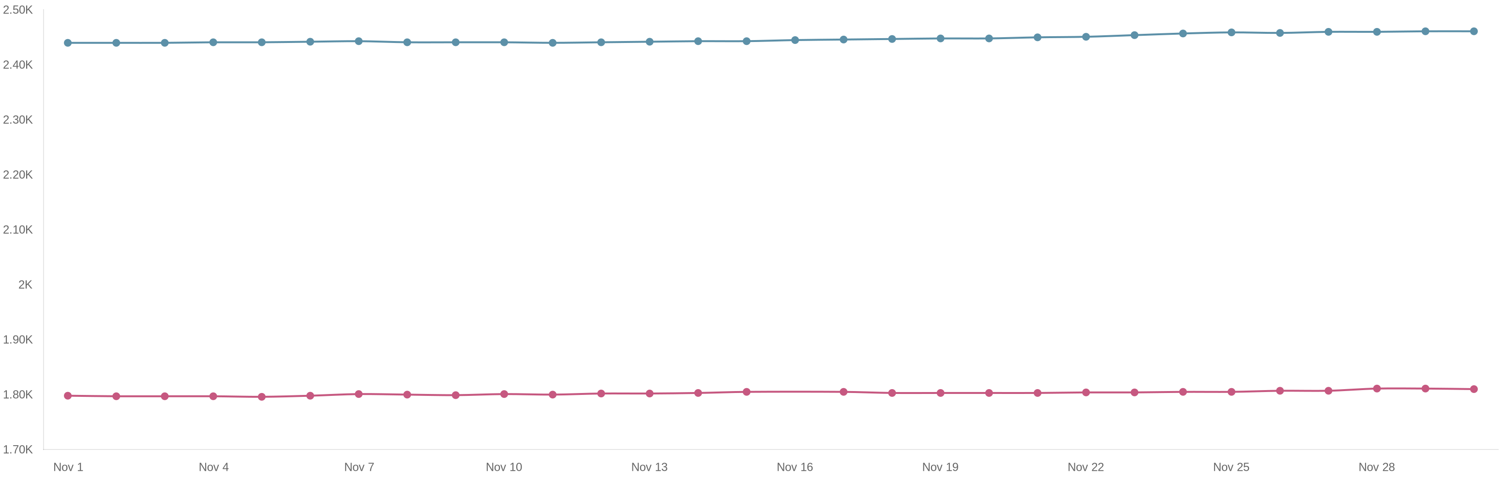
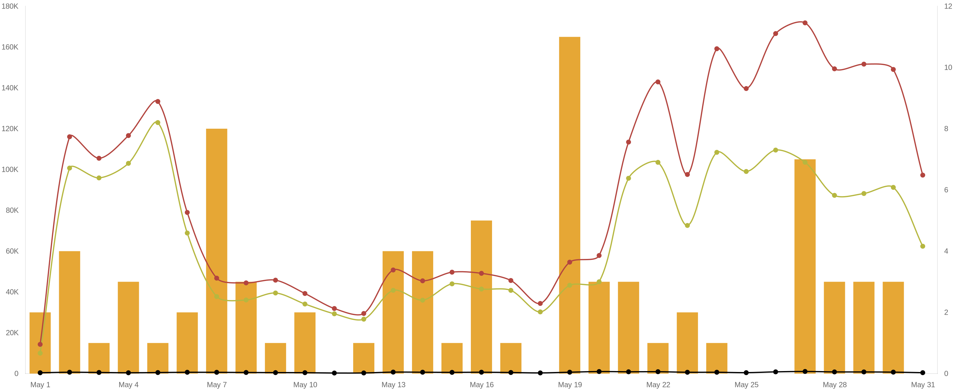


4271
+0.78%
Followers
Spinal Care Clinics - Brentwood
2461
+0.86%
1810
+0.67%
Facebook
Instagram
01 Nov 25
30 Nov 25
-

Slide 3

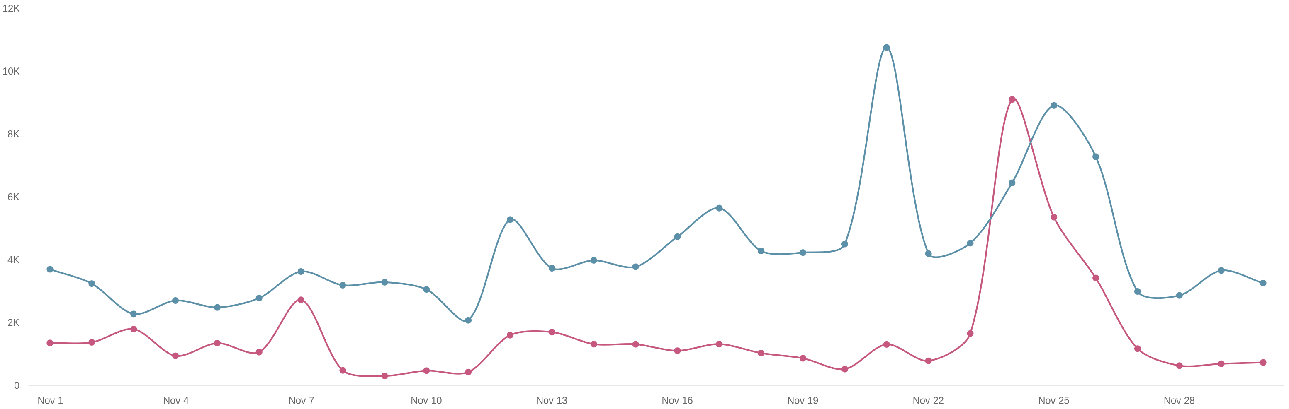
175.42K
+40.05%
Impressions
Spinal Care Clinics - Brentwood
127.51K
+24.01%
47.91K
+113.56%
Facebook
Instagram
01 Nov 25
30 Nov 25
-

Slide 4

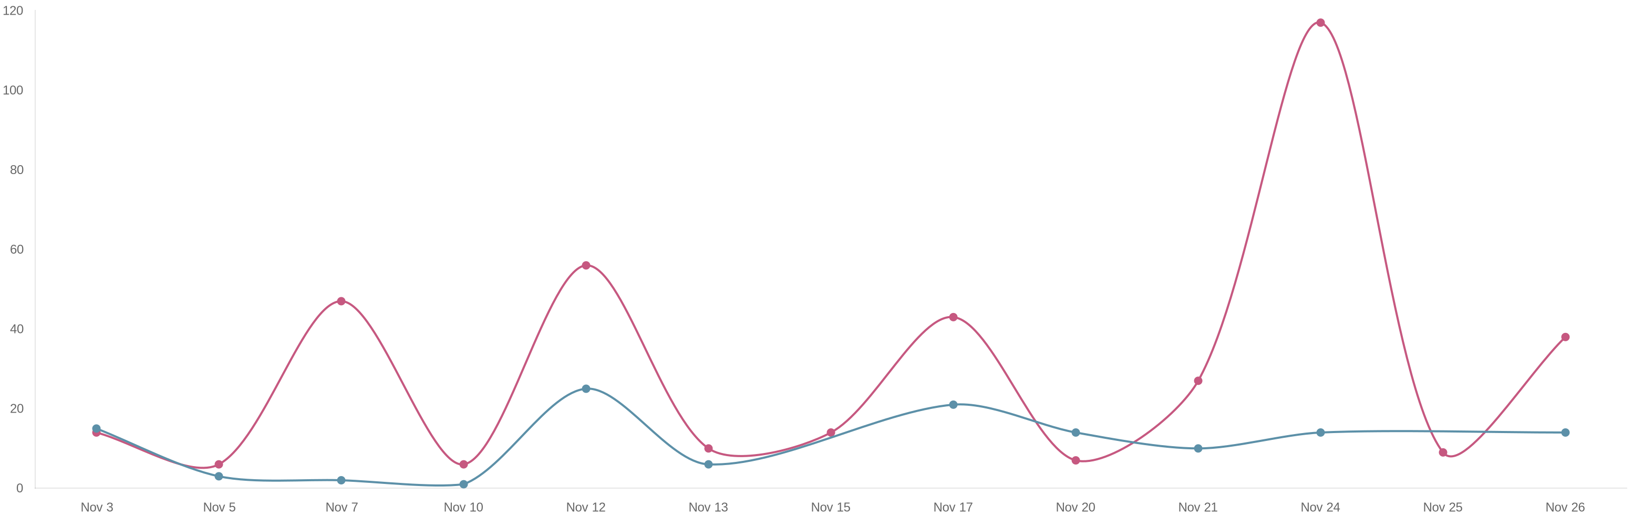
519
-10.36%
Interactions
Spinal Care Clinics - Brentwood
125
-50.79%
394
+21.23%
Facebook
Instagram
01 Nov 25
30 Nov 25
-

Slide 5

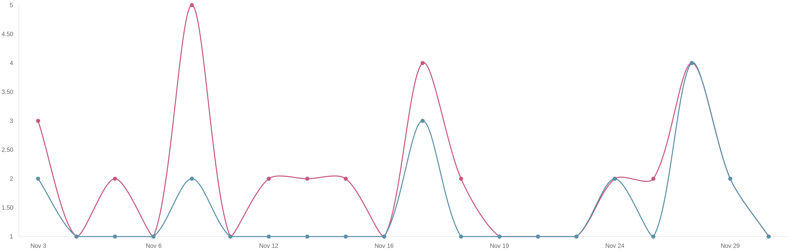
69
+21.05%
Posts
Spinal Care Clinics - Brentwood
29
+20.83%
40
+21.21%
Facebook
Instagram
01 Nov 25
30 Nov 25
-

Slide 6
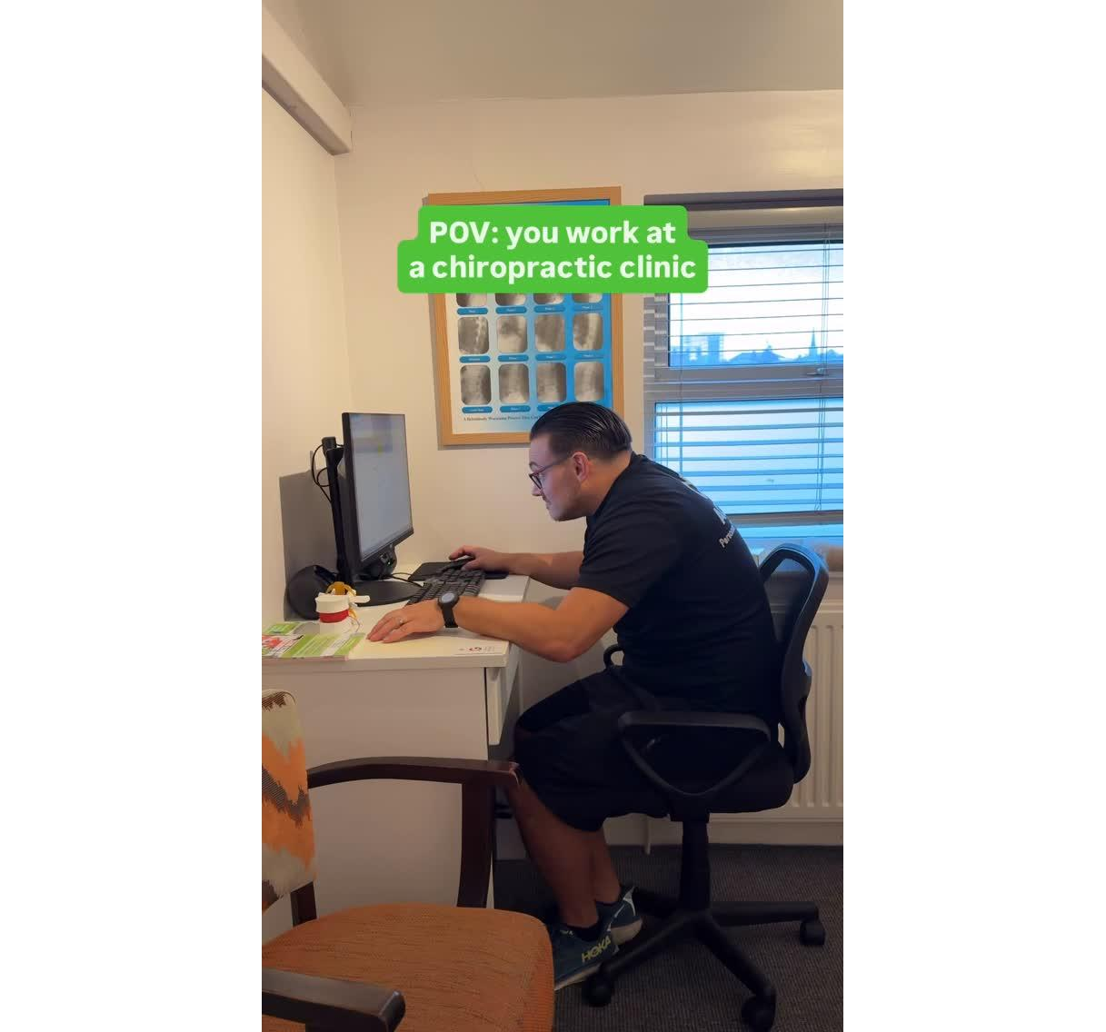
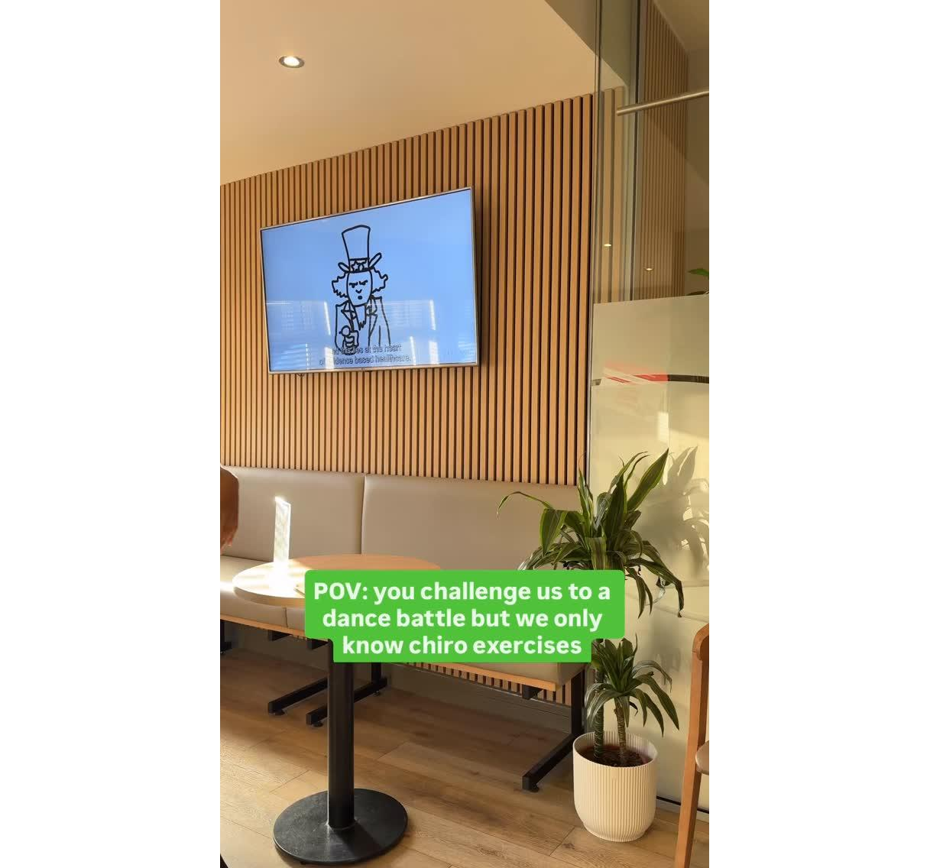
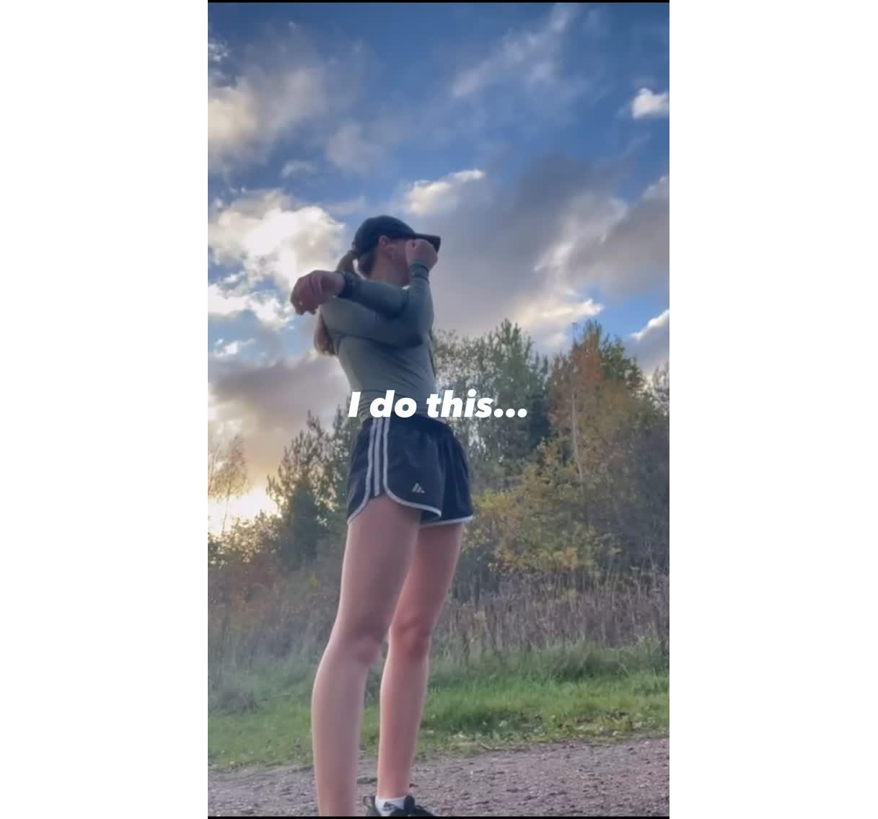
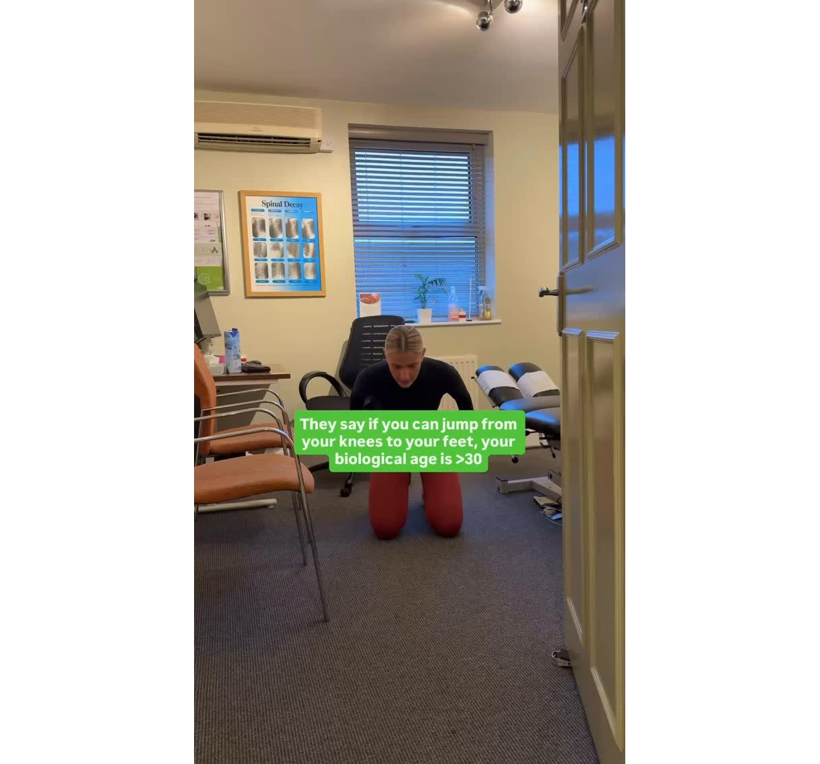



Ranking of posts
Spinal Care Clinics - Brentwood
Showing 20 posts sorted by social network
Published |  | Text |  |  | Impressions | Interactions
Nov 20, 2025 1:08 AM |  | Think rest is helping your recovery? It might be doing the opposite. 🛏 Too much rest can cause joi... | Go |  | 852 | 7
Nov 3, 2025 10:23 PM |  | You think the chiropractor’s table is scary? Wait until you see what we find terrifying. Swipe throu... | Go |  | 1152 | 14
Nov 27, 2025 12:35 AM |  | I bet everyone can relate, this is your reminder to adjust your posture right now! 🙂‍↕️ #chiroprac... | Go |  | 1297 | 14
Nov 26, 2025 1:15 AM |  | Stay tuned towards the end to see our favourite chiro dance 🤣! #chiropracticadjustment #essexchir... | Go |  | 1182 | 24
Nov 25, 2025 10:13 AM |  | Here’s Erin ✨ “I do this… so I can run my best.” 🏃‍♀️🔥 Small daily habits make the big goals possi... | Go |  | 1040 | 9
Nov 25, 2025 12:32 AM |  | The team at Spinal Care Clinics had to give this one a try and let’s just say, some of us are feelin... | Go |  | 11.95k | 117
01 Nov 25
30 Nov 25
-

Slide 7
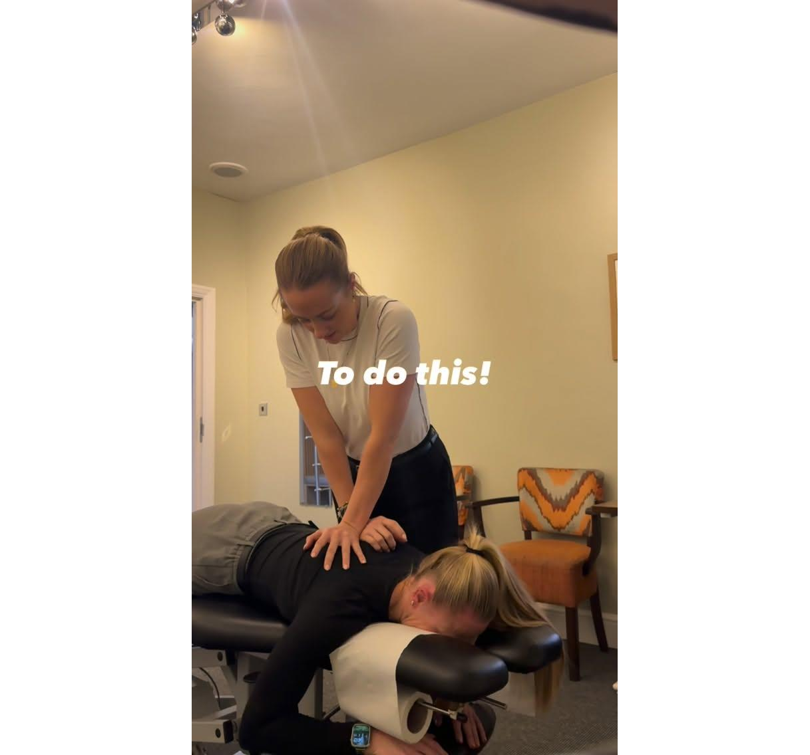
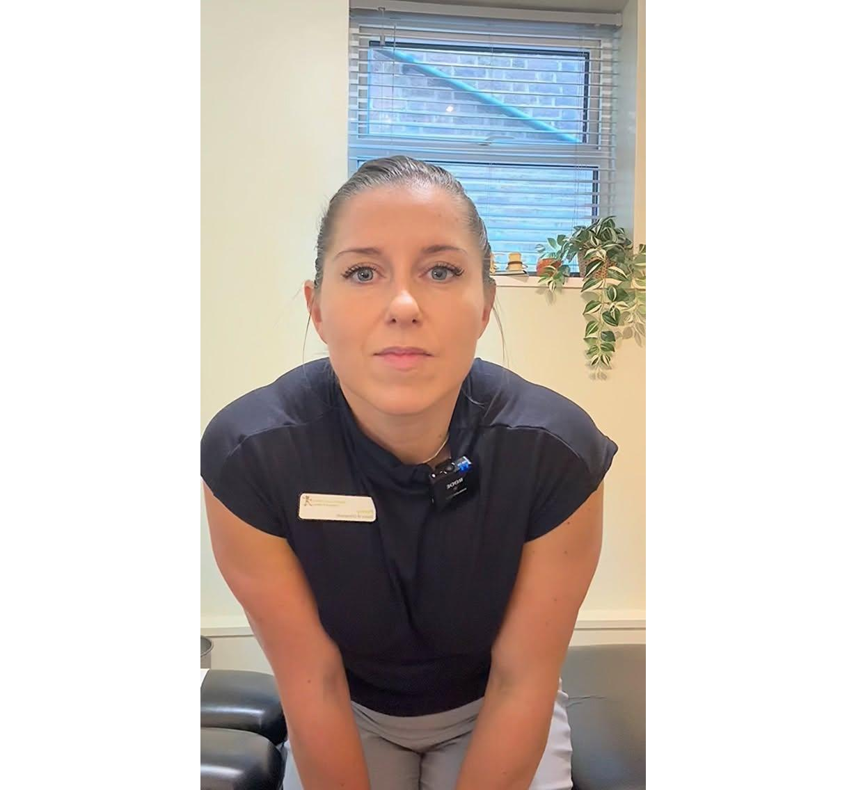
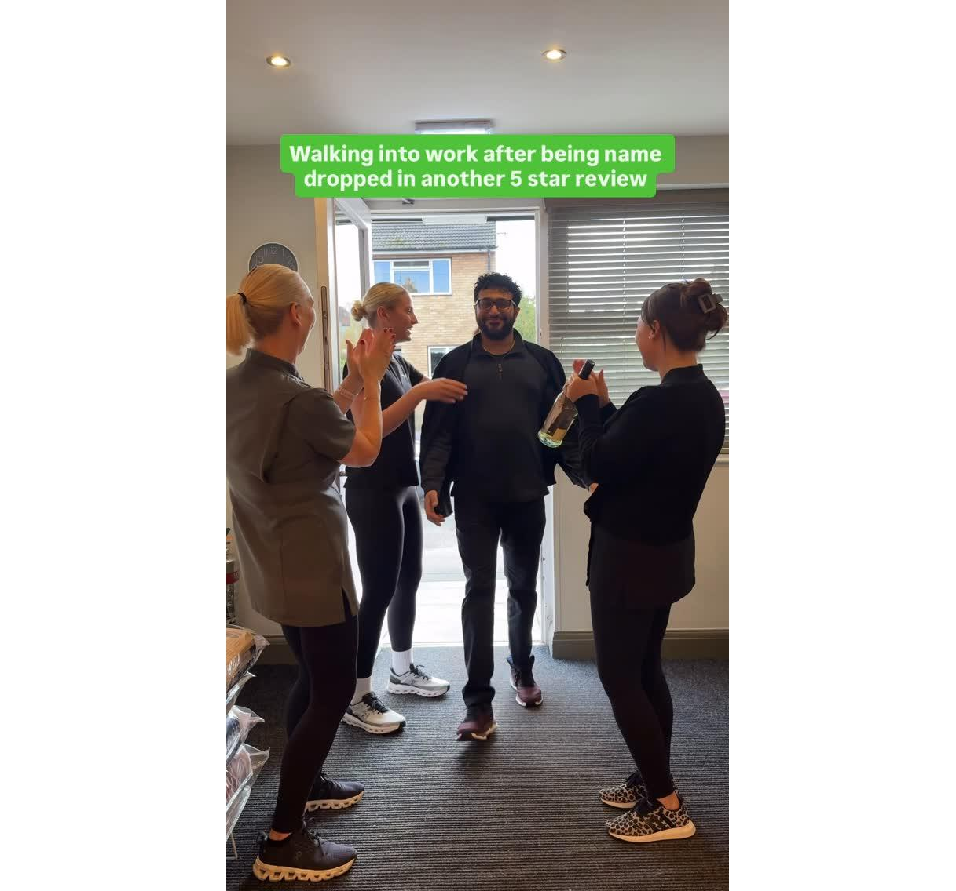
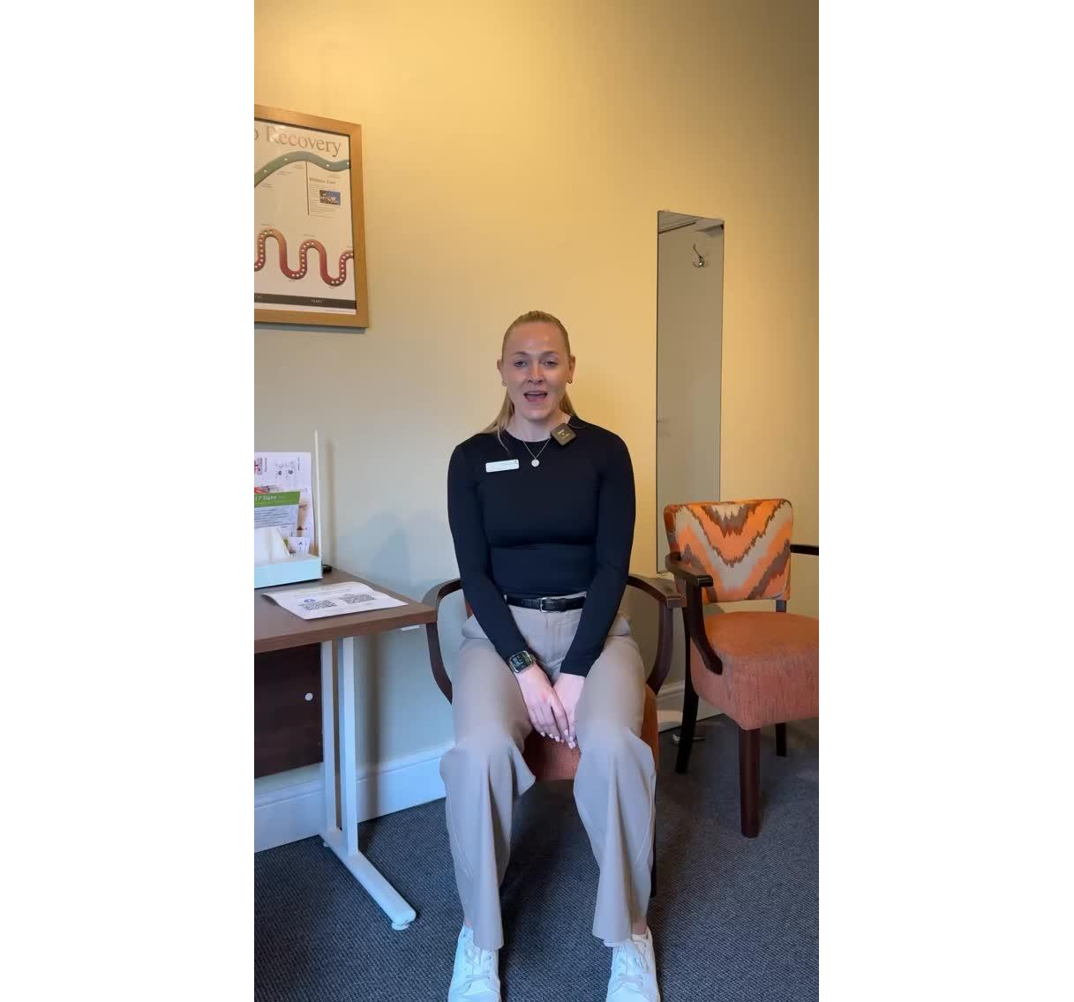
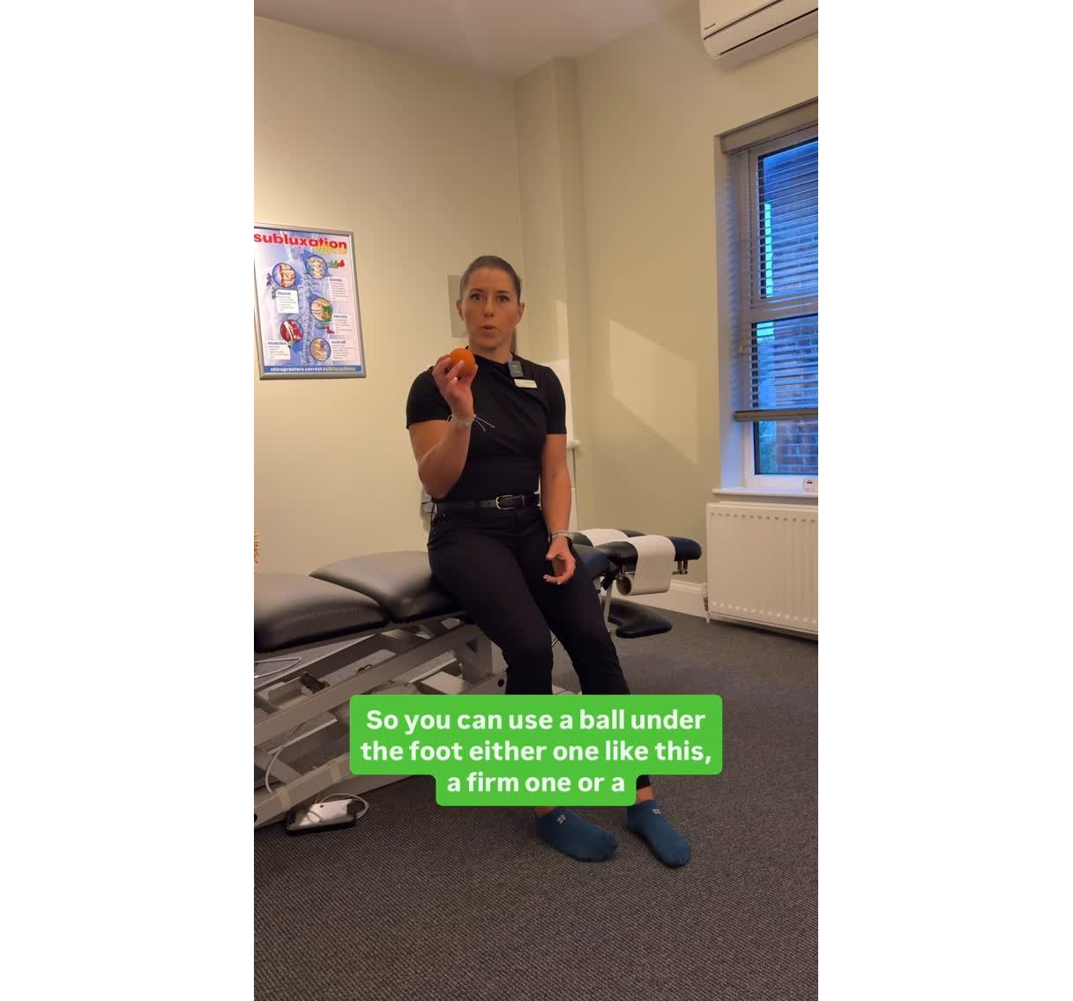
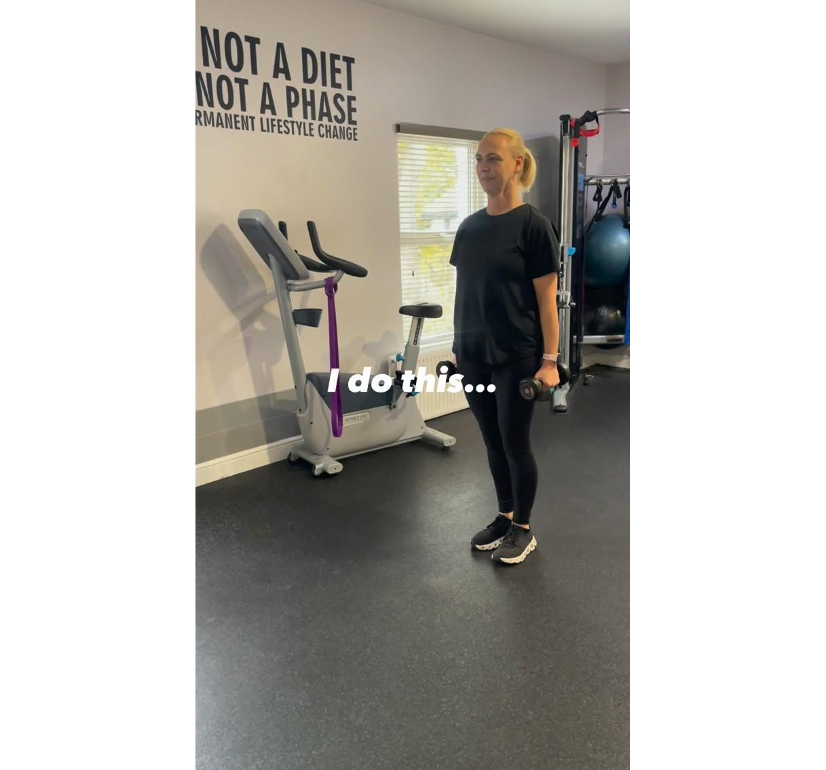
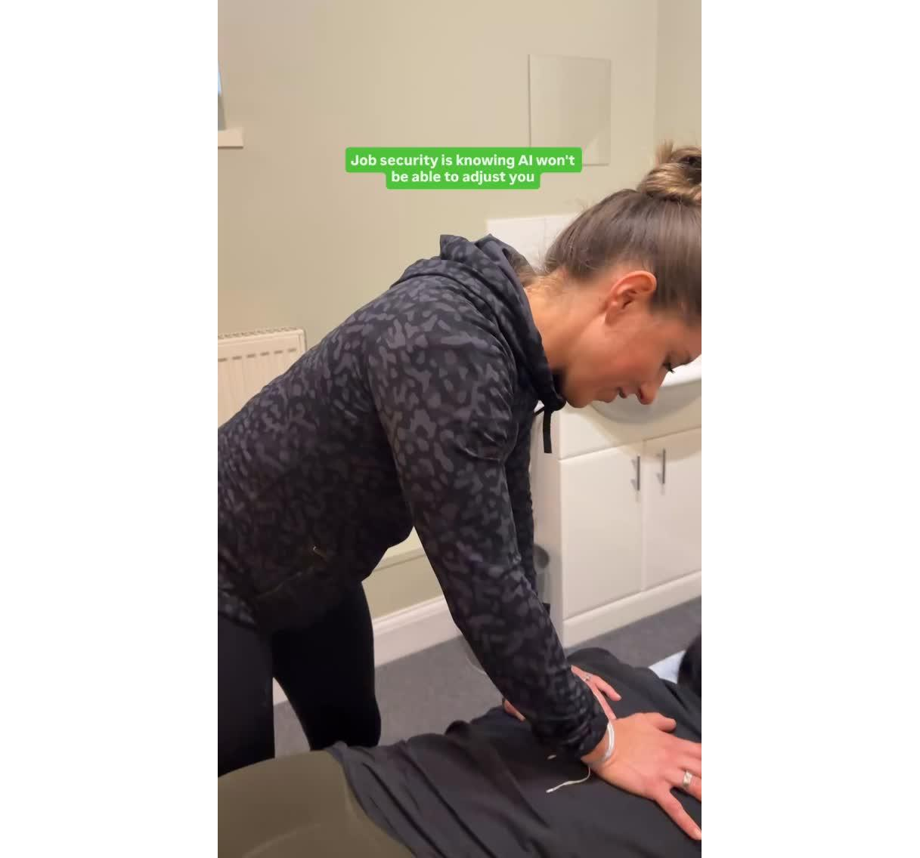
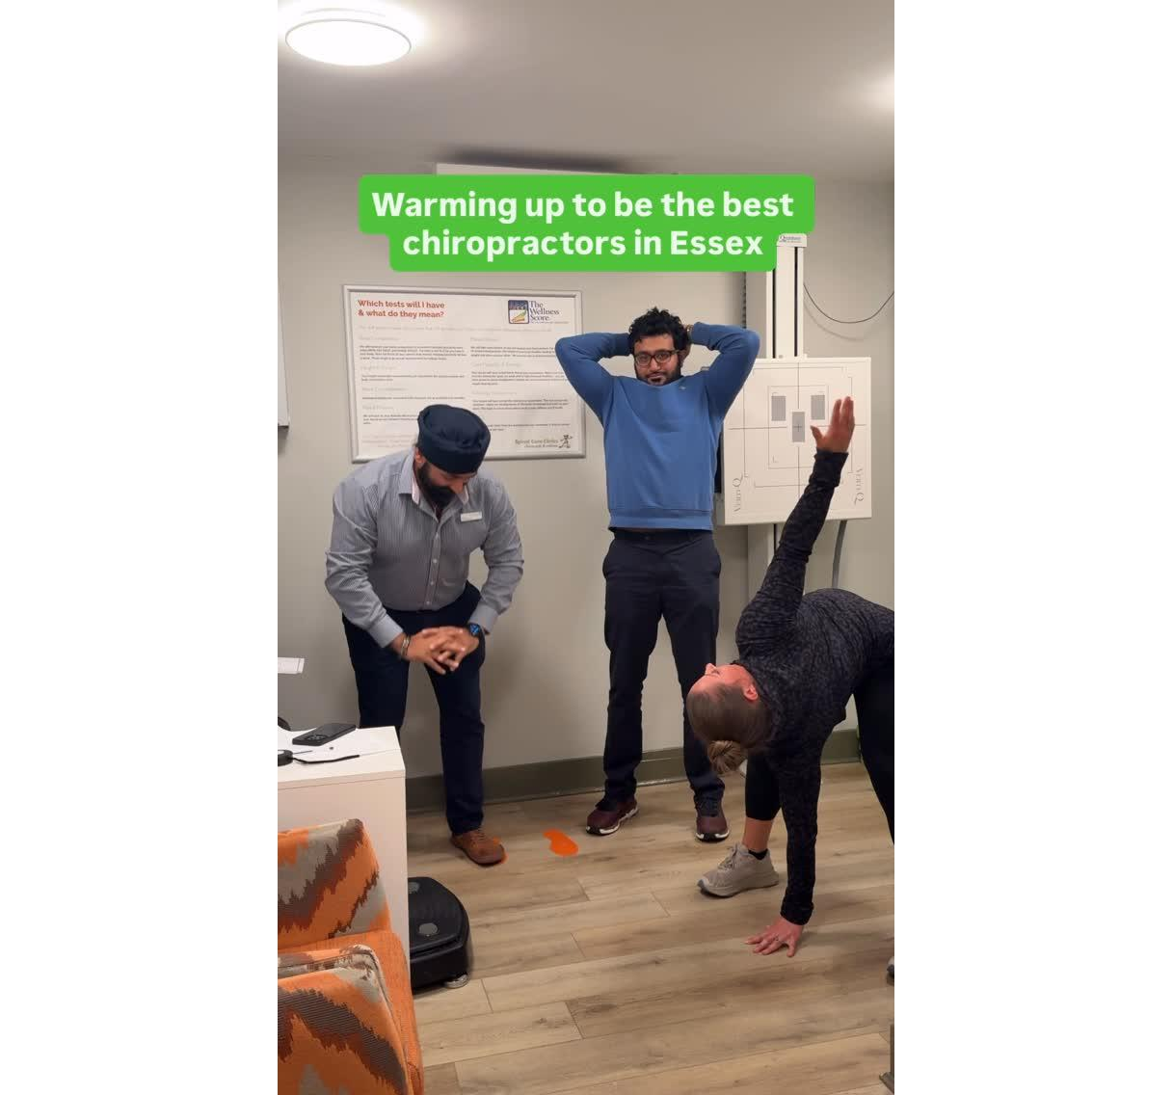
Published |  | Text |  |  | Impressions | Interactions
Nov 22, 2025 12:46 AM |  | No matter how advanced technology gets, nothing replaces the skill, precision and human touch of a t... | Go |  | 1388 | 27
Nov 18, 2025 12:20 AM |  | Warmed up and waiting for you 👋 #spinalcareclinics #chiropracticcare #backpainrelief #healthylivin... | Go |  | 1055 | 43
Nov 15, 2025 10:18 AM |  | “I do this… so I can do this” - That’s the ACTiV8 mindset! 🙌 Jess is building strength in the gym ... | Go |  | 1024 | 14
Nov 13, 2025 11:04 PM |  | Do you know the secret behind faster recovery after workouts? It is not just stretching or protein s... | Go |  | 568 | 10
Nov 12, 2025 10:20 PM |  | Our chiropractors are embracing their main character energy after seeing their 10/10 google reviews ... | Go |  | 1828 | 56
Nov 10, 2025 9:58 PM |  | Ever thought about how much strain your commute puts on your spine? The good news is small adjustmen... | Go |  | 378 | 6
Nov 7, 2025 11:23 AM |  | Struggling with plantar fasciitis? 👣 That sharp heel pain first thing in the morning or after sitt... | Go |  | 580 | 22
Nov 7, 2025 10:00 AM |  | “I do this… so I can do this” - That’s the ACTiV8 mindset! 🙌 Nicki’s putting in the work at the gy... | Go |  | 1029 | 25
01 Nov 25
30 Nov 25
-

Slide 8

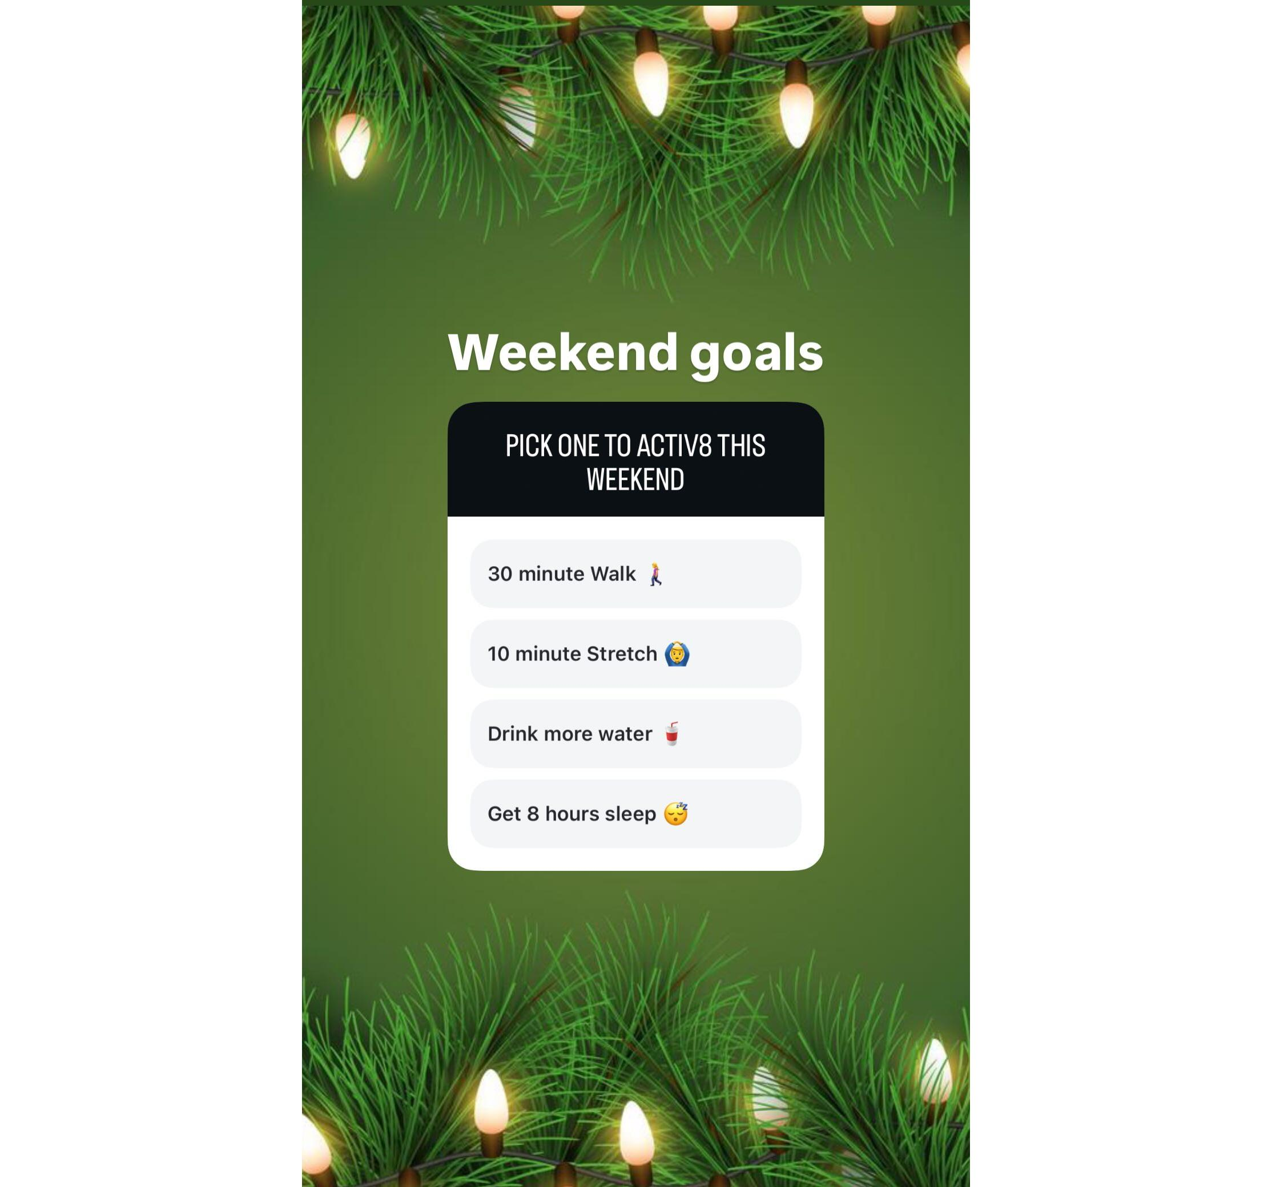
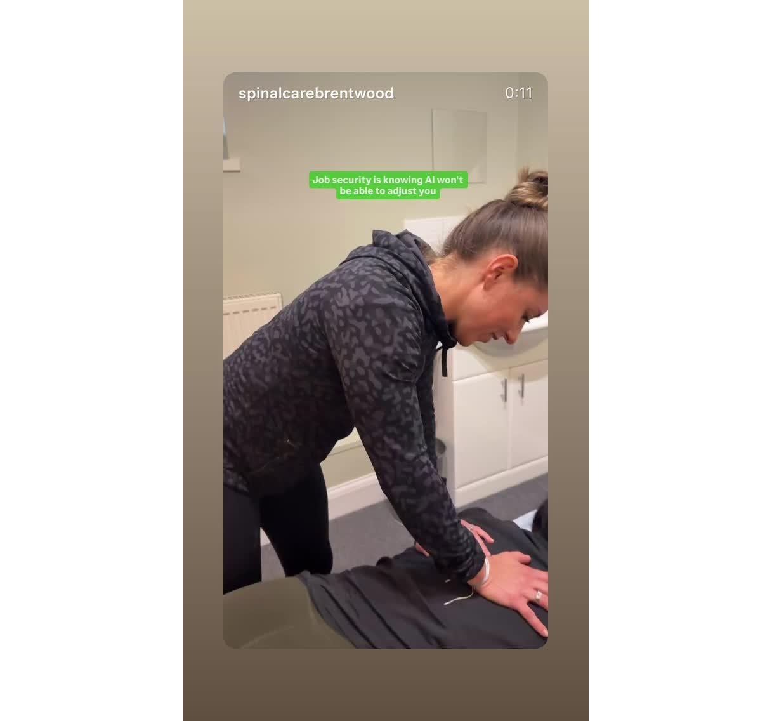

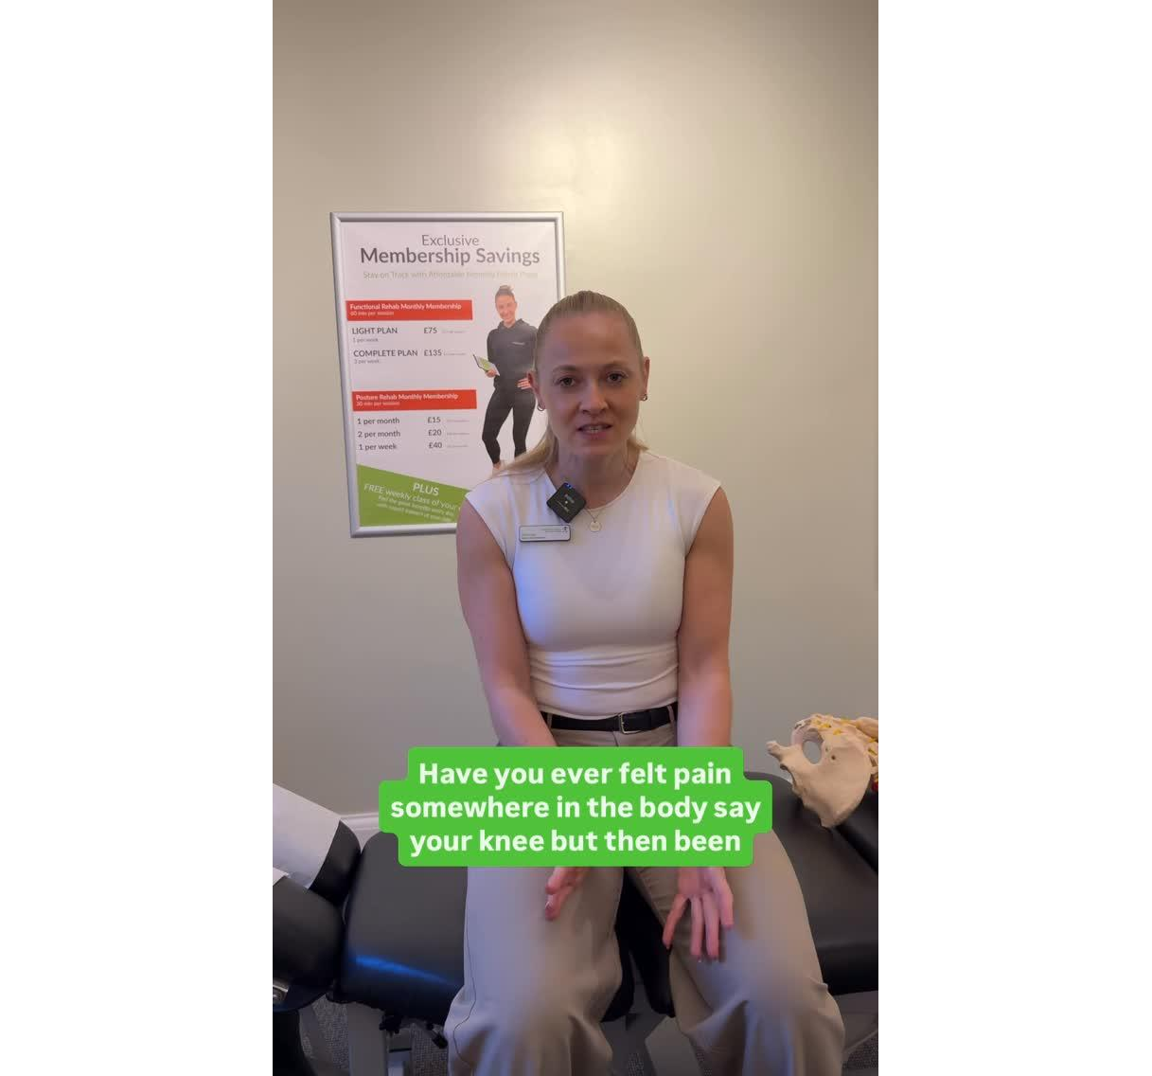

Published |  | Text |  |  | Impressions | Interactions
Nov 5, 2025 11:33 PM |  | That pain in your leg or shoulder might not be what it seems Referred pain happens when the true pr... | Go |  | 446 | 6
Nov 30, 2025 9:20 PM |  | - | Go |  | - | -
Nov 30, 2025 12:36 AM |  | Thank you to everyone who made it out to our Christmas Quiz tonight! We had so much fun & raised ove... | Go |  | 182 | -
Nov 29, 2025 11:51 AM |  | Weekend goals | Go |  | 124 | -
Nov 26, 2025 9:57 PM |  | - | Go |  | 78 | -
Nov 26, 2025 9:57 PM |  | - | Go |  | 96 | -
01 Nov 25
30 Nov 25
-

Slide 9
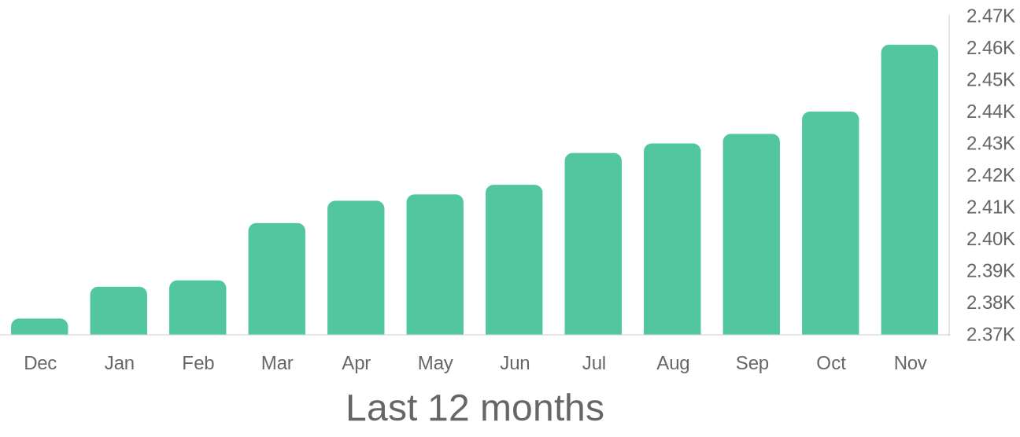
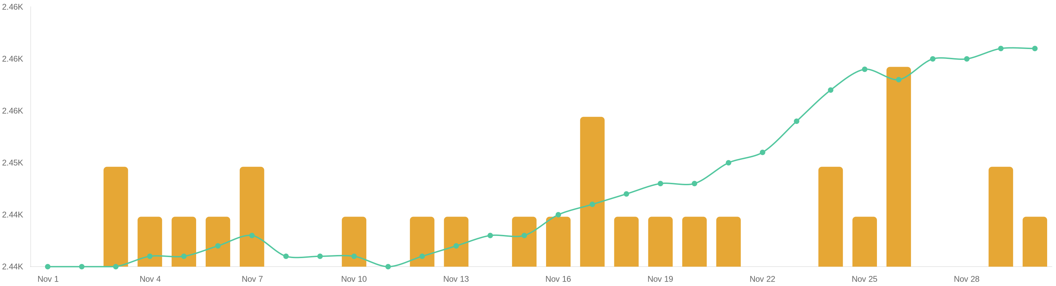
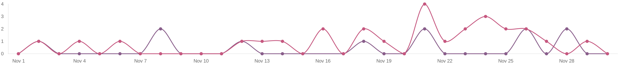
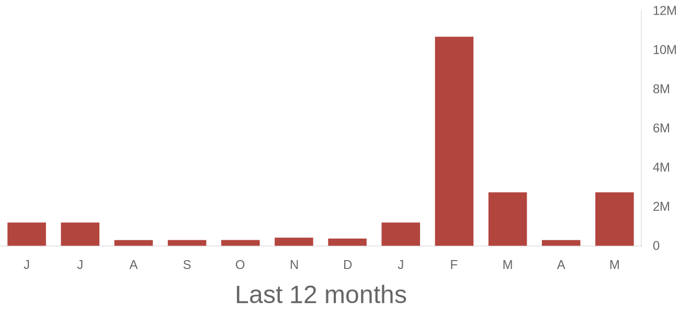
Community growth
Spinal Care Clinics - Brentwood
2461
+0.86%
29
+20.83%
27
+125.00%
11
+120.00%
Followers
Total content
Acquired
Lost
01 Nov 25
30 Nov 25
-

Slide 10
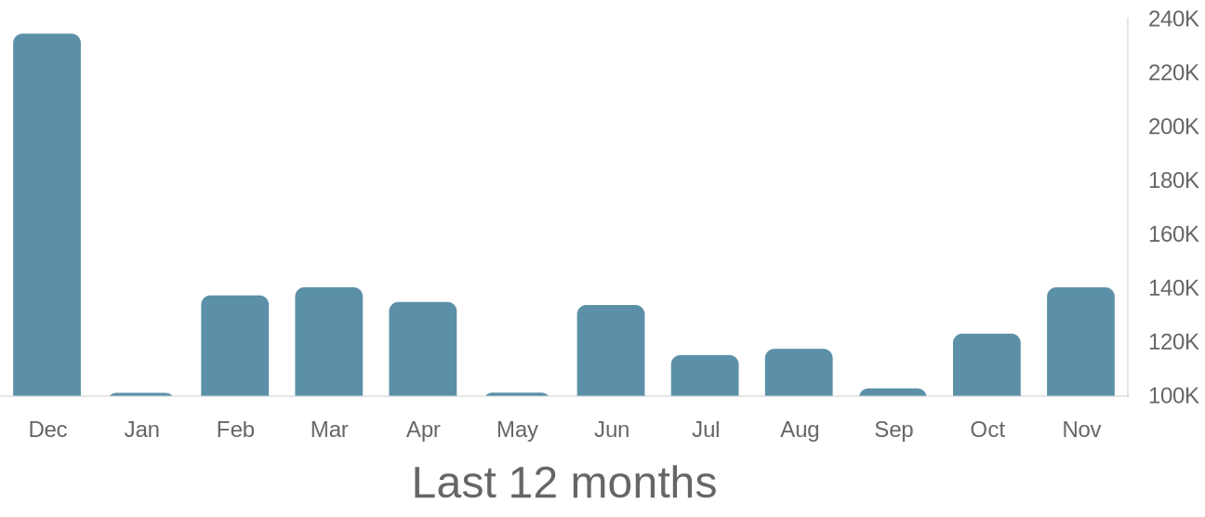
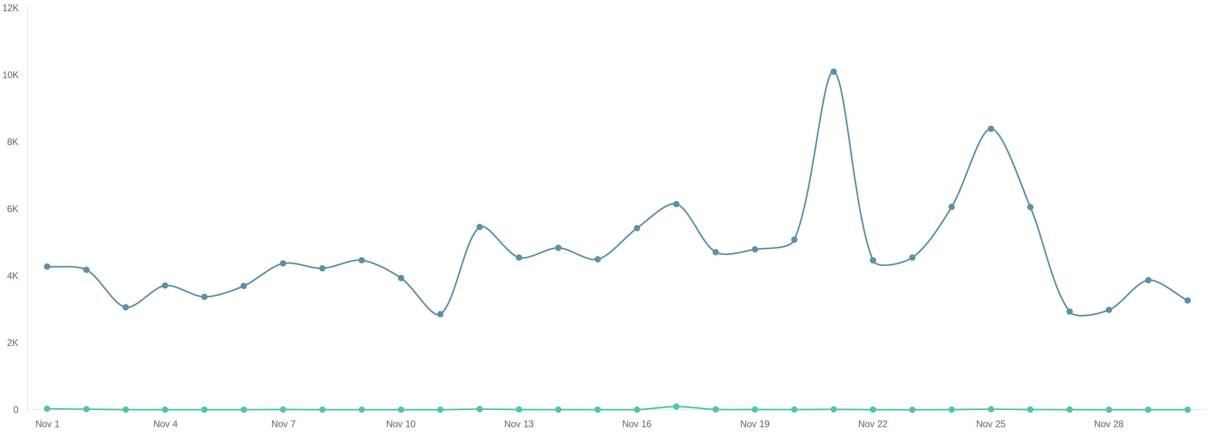
Posts viewed in period
Spinal Care Clinics - Brentwood
140.29K
+13.98%
294
+51.55%
Impressions
Reactions
01 Nov 25
30 Nov 25
-

Slide 11
Demographics: countries and cities
Spinal Care Clinics - Brentwood
Top 10 countries
Top 10 cities
United Kingdom | 98.50%
United States | 1.34%
Romania | 0.73%
Australia | 0.41%
Lithuania | 0.37%
United Arab Emirates | 0.37%
Spain | 0.37%
Philippines | 0.33%
Israel | 0.28%
India | 0.28%
Brentwood, UK | 16.98%
London, UK | 7.92%
Basildon, UK | 7.31%
Hornchurch, UK | 6.05%
Chelmsford, UK | 3.74%
Grays, UK | 3.70%
Billericay, UK | 3.45%
Romford, UK | 3.45%
Upminster, UK | 3.29%
South Ockendon, UK | 3.05%
01 Nov 25
30 Nov 25
-

Slide 12
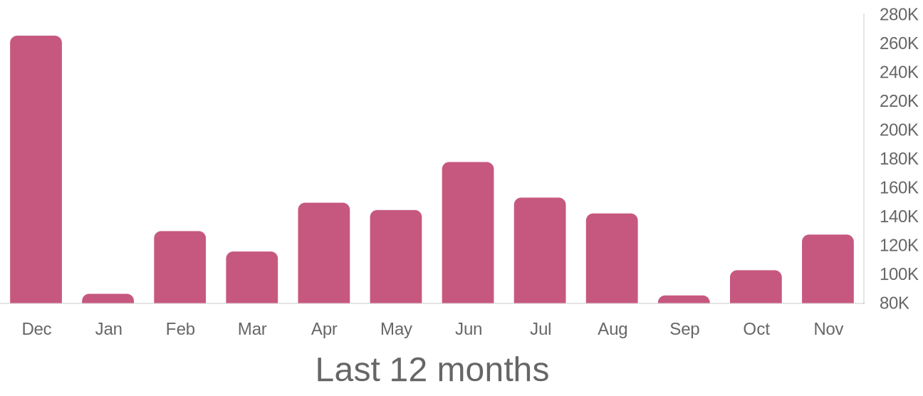
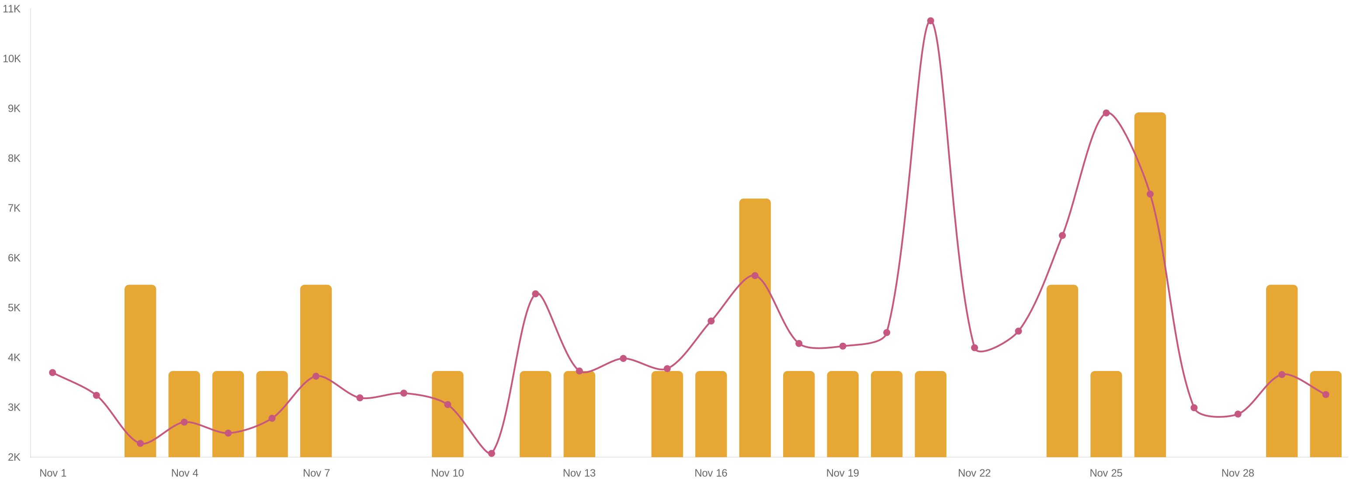
Content Views on the page
Spinal Care Clinics - Brentwood
127.51K
+24.01%
29
+20.83%
Views
Total content
01 Nov 25
30 Nov 25
-

Slide 13
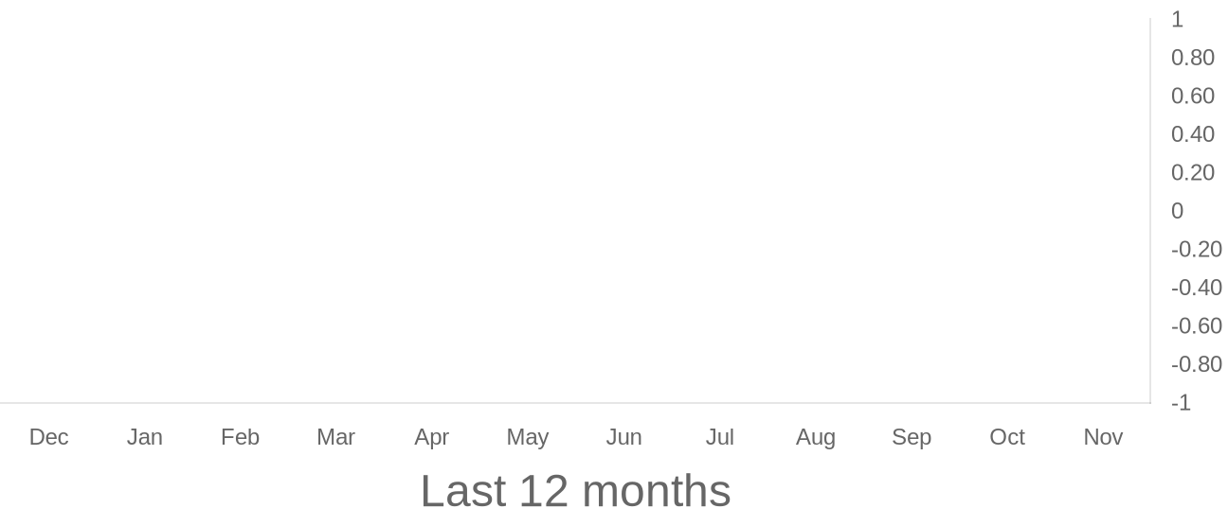
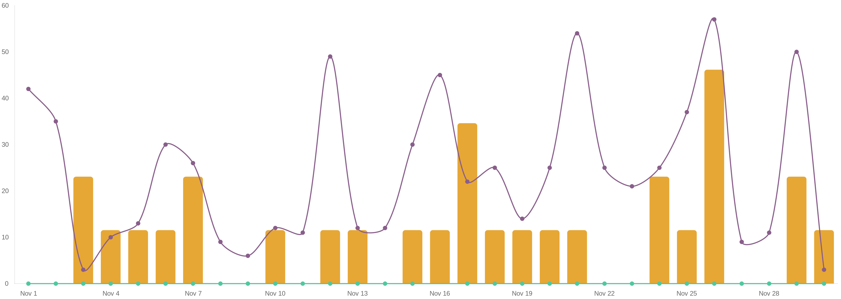
Clicks on page
Spinal Care Clinics - Brentwood
0
723
+5.86%
29
+20.83%
Total clicks
Page views
Total content
01 Nov 25
30 Nov 25
-

Slide 14
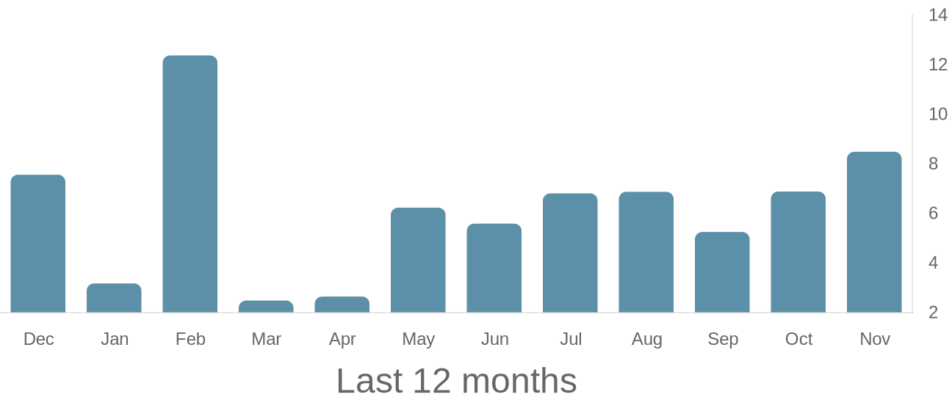
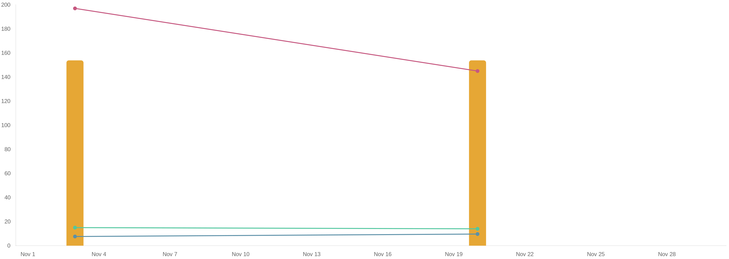
Posts published in period
Spinal Care Clinics - Brentwood
8.48
+23.36%
29
-65.48%
171
-58.02%
2
-33.33%
Engagement
Interactions
Avg reach per post
Posts
01 Nov 25
30 Nov 25
-

Slide 15
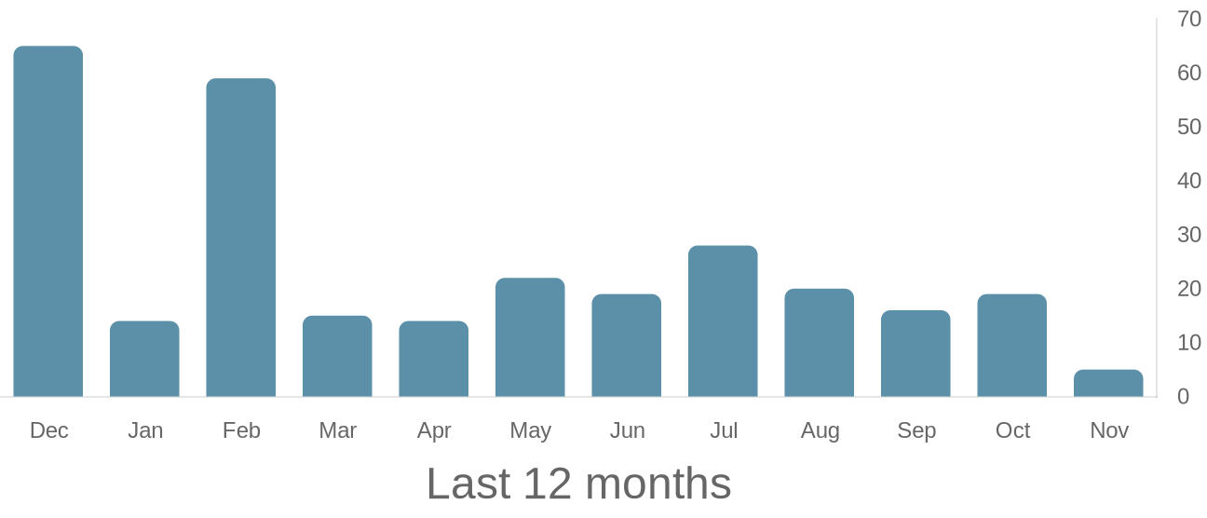
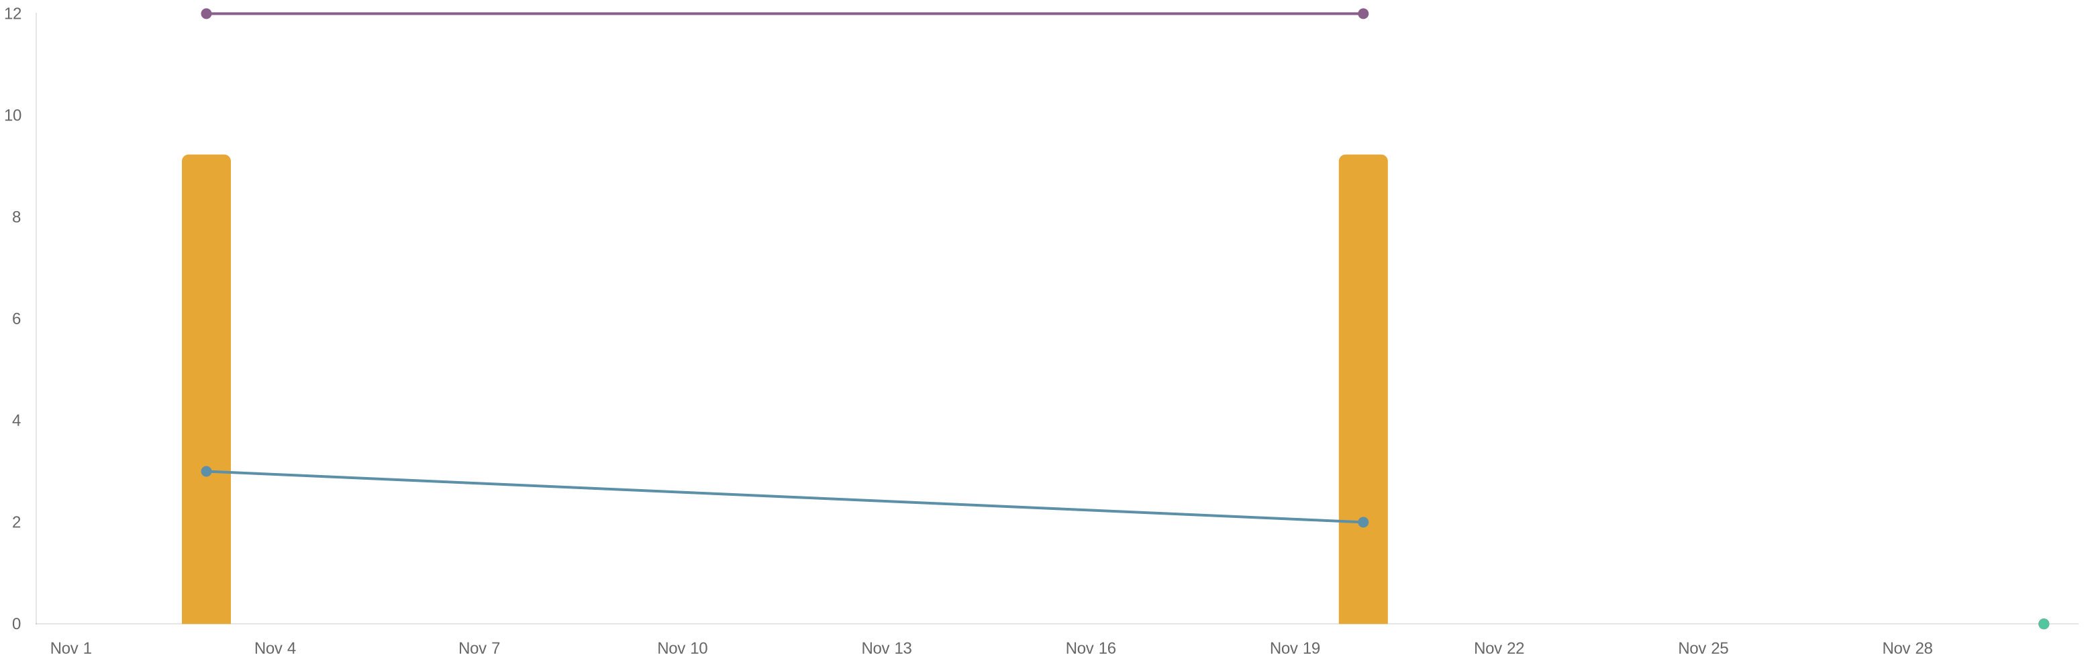
Interactions of published posts
Spinal Care Clinics - Brentwood
5
-73.68%
0
0
24
-61.90%
Reactions
Comments
Shares
Clicks
2
-33.33%
Posts
01 Nov 25
30 Nov 25
-

Slide 16



Ranking of posts
Spinal Care Clinics - Brentwood
Showing 2 posts sorted by reach
Published |  | Type | Text |  | Reactions | Comments | Shares | Clicks | Link clicks | Impressions | Reach | Video views | Engagement
Nov 3, 2025 9:23 PM |  |  | You think the chiropractor’s t... | Go | 3 | 0 | 0 | 12 | 0 | 339 | 197 | 0 | 7.61
Nov 20, 2025 12:08 AM |  |  | Think rest is helping your rec... | Go | 2 | 0 | 0 | 12 | 0 | 256 | 145 | 0 | 9.66
01 Nov 25
30 Nov 25
-

Slide 17
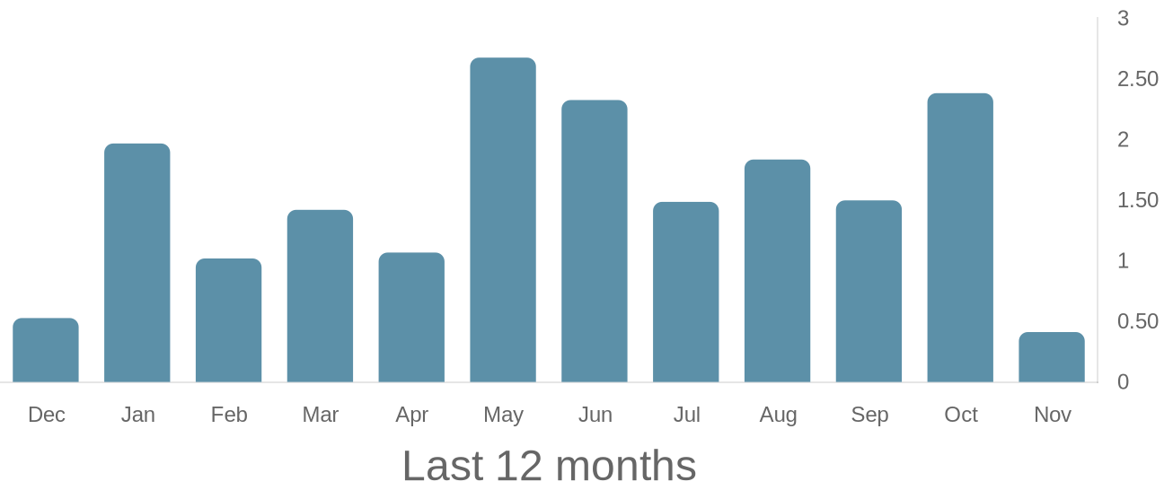
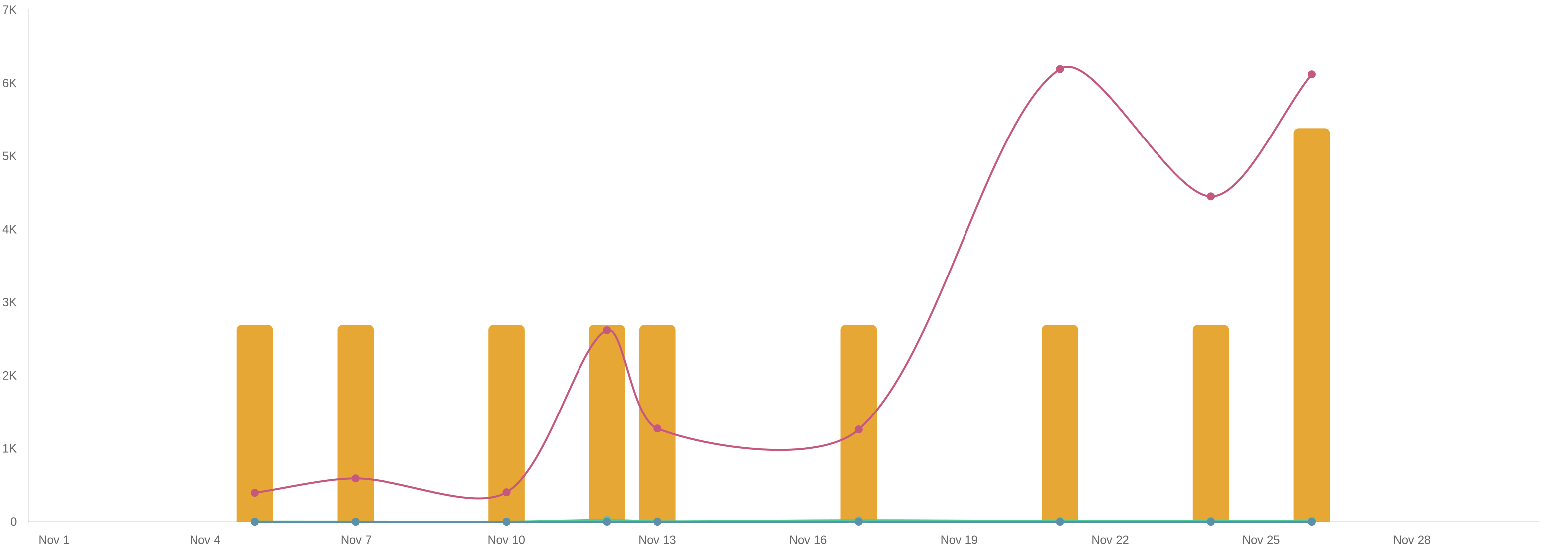
Reels published in period
Spinal Care Clinics - Brentwood
0.41
-82.72%
96
-43.53%
2331.50
+194.09%
10
+11.11%
Engagement
Interactions
Avg reach per reel
Reels
01 Nov 25
30 Nov 25
-

Slide 18
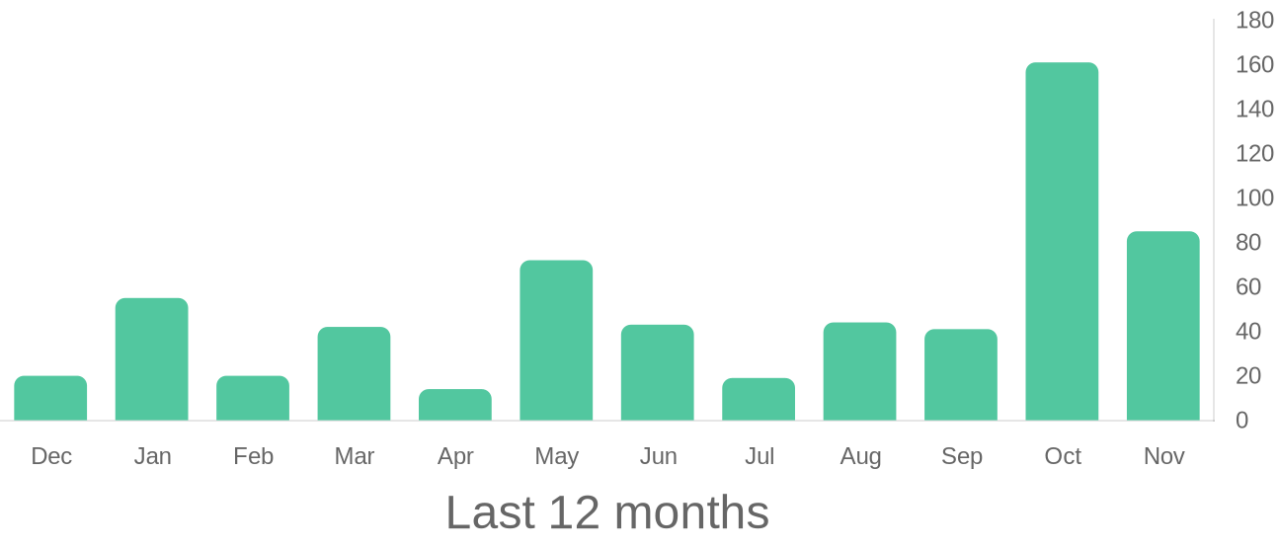
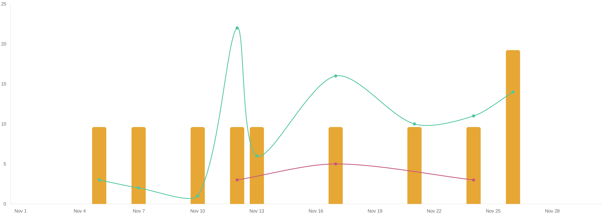
Interactions of published reels
Spinal Care Clinics - Brentwood
85
-47.20%
11
+22.22%
10
+11.11%
Likes
Actions
Reels
01 Nov 25
30 Nov 25
-

Slide 19

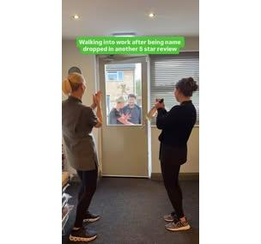
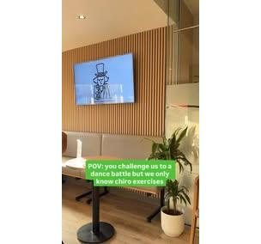


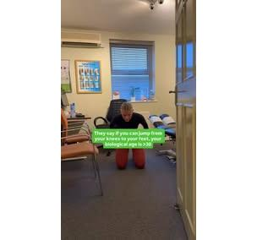
Ranking of reels
Spinal Care Clinics - Brentwood
Showing 10 posts sorted by reach
Published |  | Text |  | Video views | Reach | Likes | Actions | Engagement | Time watched | Avg. time watched
Nov 21, 2025 11:47 PM |  | No matter how advanced technol... | Go | 6125 | 6194 | 10 | 0 | 0.16 | 9h 19m 39s | 5s
Nov 24, 2025 11:32 PM |  | The team at Spinal Care Clinic... | Go | 4394 | 4451 | 11 | 3 | 0.31 | 10h 33m 47s | 8s
Nov 26, 2025 11:36 PM |  | I bet everyone can relate to t... | Go | 3506 | 3566 | 5 | 0 | 0.14 | 6h 48m 34s | 6s
Nov 12, 2025 9:20 PM |  | Our chiropractors are embracin... | Go | 2638 | 2619 | 22 | 3 | 0.95 | 4h 47m 12s | 6s
Nov 26, 2025 12:15 AM |  | Stay tuned towards the end to ... | Go | 2585 | 2556 | 9 | 0 | 0.35 | 3h 52m 2s | 5s
Nov 13, 2025 10:05 PM |  | Do you know the secret behind ... | Go | 1305 | 1275 | 6 | 0 | 0.47 | 1h 41m 53s | 4s
01 Nov 25
30 Nov 25
-

Slide 20
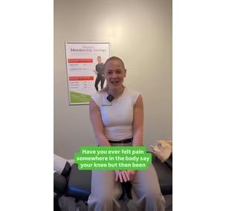
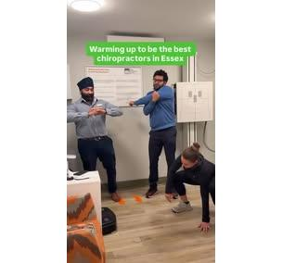
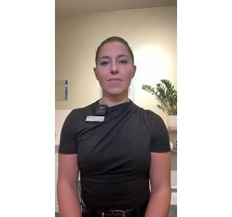

Published |  | Text |  | Video views | Reach | Likes | Actions | Engagement | Time watched | Avg. time watched
Nov 17, 2025 11:20 PM |  | Warmed up and waiting for you ... | Go | 1323 | 1262 | 16 | 5 | 1.66 | 2h 14m 58s | 6s
Nov 7, 2025 10:23 AM |  | Struggling with plantar fascii... | Go | 596 | 593 | 2 | 0 | 0.34 | 1h 27m 55s | 8s
Nov 10, 2025 8:58 PM |  | Ever thought about how much st... | Go | 405 | 403 | 1 | 0 | 0.25 | 1h 3m 19s | 9s
Nov 5, 2025 10:34 PM |  | That pain in your leg or shoul... | Go | 401 | 396 | 3 | 0 | 0.76 | 52m 43s | 7s
01 Nov 25
30 Nov 25
-

Slide 21
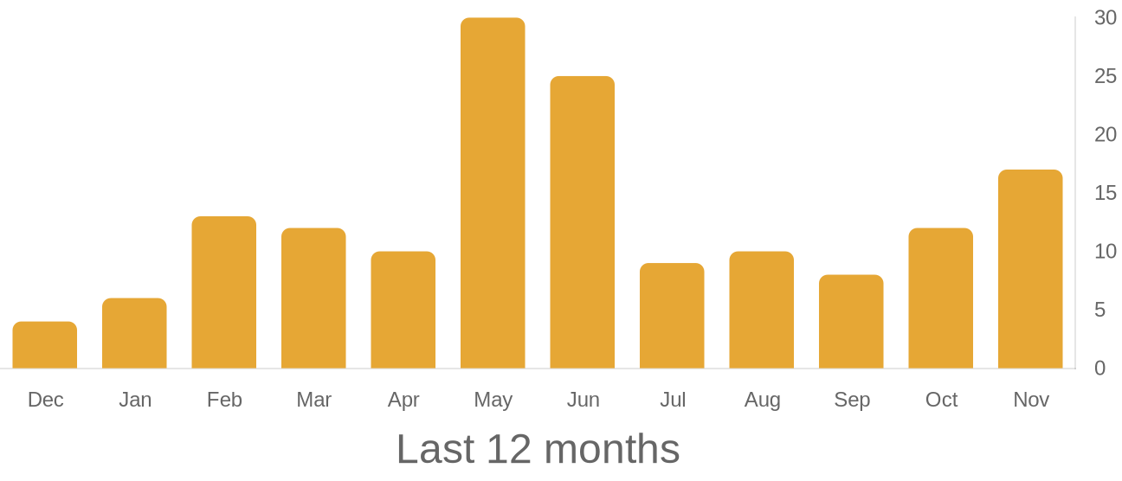
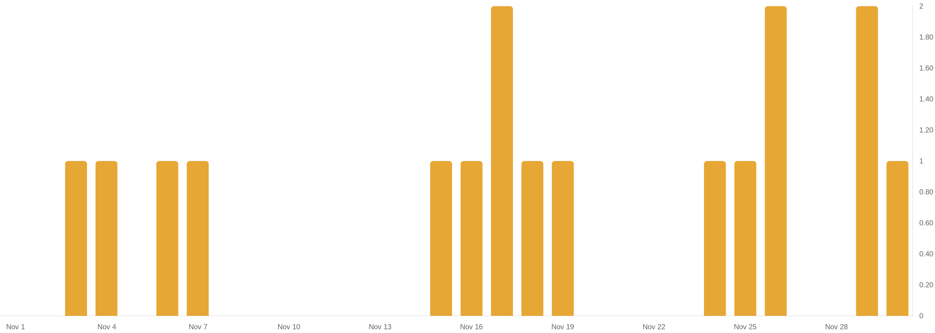
Stories published in period
Spinal Care Clinics - Brentwood
17
+41.67%
Stories
01 Nov 25
30 Nov 25
-

Slide 22
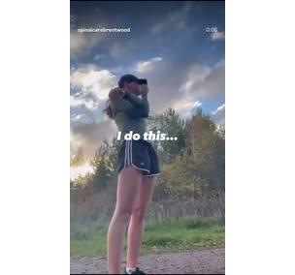


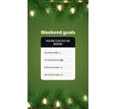
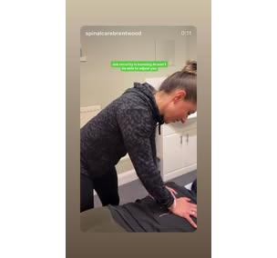

Ranking of stories
Spinal Care Clinics - Brentwood
Showing 17 stories sorted by date
Published |  | Type
Nov 30, 2025 8:20 PM |  | Photo
Nov 29, 2025 11:36 PM |  | Photo
Nov 29, 2025 10:52 AM |  | Photo
Nov 26, 2025 8:58 PM |  | Video
Nov 26, 2025 8:57 PM |  | Video
Nov 25, 2025 9:25 AM |  | Video
01 Nov 25
30 Nov 25
-

Slide 23
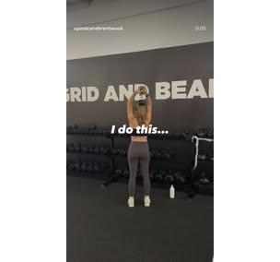







Published |  | Type
Nov 24, 2025 10:01 AM |  | Photo
Nov 19, 2025 8:31 AM |  | Photo
Nov 18, 2025 8:21 PM |  | Photo
Nov 17, 2025 8:21 PM |  | Video
Nov 17, 2025 8:19 PM |  | Photo
Nov 16, 2025 2:15 PM |  | type
Nov 15, 2025 9:19 AM |  | Video
Nov 7, 2025 5:53 PM |  | Photo
01 Nov 25
30 Nov 25
-

Slide 24



Published |  | Type
Nov 6, 2025 9:18 AM |  | Photo
Nov 4, 2025 9:34 PM |  | Photo
Nov 3, 2025 9:43 PM |  | Photo
01 Nov 25
30 Nov 25
-

Slide 25



Community growth
spinalcarebrentwood
1810
+0.67%
12
40
+21.21%
Followers
Followers balance
Total content
01 Nov 25
30 Nov 25
-

Slide 26


Demographics: gender and age
spinalcarebrentwood
Gender
Ages
01 Nov 25
30 Nov 25
-

Slide 27
Demographics: countries and cities
spinalcarebrentwood
Top 10 countries
Top 10 cities
United Kingdom | 83.62%
United States | 6.45%
India | 0.99%
Canada | 0.93%
Australia | 0.64%
Venezuela | 0.52%
United Arab Emirates | 0.46%
Spain | 0.46%
France | 0.46%
Philippines | 0.41%
Brentwood, England | 16.84%
Hornchurch, England | 5.46%
Chelmsford, England | 4.70%
London, England | 4.65%
Romford, England | 3.89%
Basildon, England | 2.73%
Billericay, England | 2.67%
Upminster, England | 2.50%
Harold Wood, England | 2.21%
Dagenham, England | 1.92%
01 Nov 25
30 Nov 25
-

Slide 28


Average reach per day
spinalcarebrentwood
47.91K
+113.56%
1027
+253.47%
40
+21.21%
Views
Average reach per day
Total content
01 Nov 25
30 Nov 25
-

Slide 29


Posts published in period
spinalcarebrentwood
4.18
-17.76%
2
-33.33%
Engagement
Posts
01 Nov 25
30 Nov 25
-

Slide 30


Reach of published posts
spinalcarebrentwood
251
-12.95%
2
-33.33%
Avg reach per post
Posts
01 Nov 25
30 Nov 25
-

Slide 31


Interactions of published posts
spinalcarebrentwood
18
-53.85%
2
-33.33%
0
1
-50.00%
Likes
Comments
Saved
Shares
21
-52.27%
Interactions
01 Nov 25
30 Nov 25
-

Slide 32
Ranking of posts
spinalcarebrentwood
Showing 2 posts sorted by views
Published |  | Type | Text |  | Views | Reach | Likes | Comments | Saved | Engagement
Nov 3, 2025 9:23 PM |  |  | You think the chiropractor’s table is scary? Wait ... | Go | 1152 | 235 | 14 | 0 | 0 | 5.96
Nov 20, 2025 12:08 AM |  |  | Think rest is helping your recovery? It might be d... | Go | 852 | 267 | 4 | 2 | 0 | 2.62
01 Nov 25
30 Nov 25
-

Slide 33
Ranking of hashtags
spinalcarebrentwood
Showing 7 hashtags sorted by views
 | Posts | Views | Likes | Comments
#posturematters | 1 | 1152 | 14 | 0
#chiropractictruths | 1 | 1152 | 14 | 0
#spinalcareclinics | 2 | 1002 | 9 | 1
#painfreejourney | 1 | 852 | 4 | 2
#wellness | 1 | 852 | 4 | 2
#healthyliving | 1 | 852 | 4 | 2
#chiropracticcare | 1 | 852 | 4 | 2
01 Nov 25
30 Nov 25
-

Slide 34


Reels published in period
spinalcarebrentwood
2.20
-52.20%
13
+30.00%
Engagement
Reels
01 Nov 25
30 Nov 25
-

Slide 35


Reach of published reels
spinalcarebrentwood
1302.46
+113.62%
13
+30.00%
Avg reach per reel
Reels
01 Nov 25
30 Nov 25
-

Slide 36


Interactions of published reels
spinalcarebrentwood
286
+32.41%
11
-38.89%
26
+333.33%
373
+32.74%
Likes
Comments
Saved
Interactions
50
+21.95%
13
+30.00%
Shares
Reels
01 Nov 25
30 Nov 25
-

Slide 37
Ranking of reels
spinalcarebrentwood
Showing 13 posts sorted by views
Published |  | Text |  | Views | Reach | Likes | Saved | Comments | Shares | Engagement
Nov 24, 2025 11:32 PM |  | The team at Spinal Care Clinics had to give this o... | Go | 11.95k | 9535 | 64 | 20 | 4 | 29 | 1.23
Nov 12, 2025 9:20 PM |  | Our chiropractors are embracing their main charact... | Go | 1828 | 1023 | 50 | 0 | 2 | 4 | 5.47
Nov 21, 2025 11:46 PM |  | No matter how advanced technology gets, nothing re... | Go | 1388 | 979 | 24 | 2 | 0 | 1 | 2.76
Nov 26, 2025 11:35 PM |  | I bet everyone can relate, this is your reminder t... | Go | 1297 | 849 | 13 | 0 | 0 | 1 | 1.65
Nov 26, 2025 12:15 AM |  | Stay tuned towards the end to see our favourite ch... | Go | 1182 | 788 | 24 | 0 | 0 | 0 | 3.05
Nov 17, 2025 11:20 PM |  | Warmed up and waiting for you 👋 #spinalcareclini... | Go | 1055 | 664 | 40 | 1 | 1 | 1 | 6.48
01 Nov 25
30 Nov 25
-

Slide 38
Published |  | Text |  | Views | Reach | Likes | Saved | Comments | Shares | Engagement
Nov 25, 2025 9:13 AM |  | Here’s Erin ✨ “I do this… so I can run my best.” ?... | Go | 1040 | 657 | 9 | 0 | 0 | 0 | 1.37
Nov 7, 2025 9:00 AM |  | “I do this… so I can do this” - That’s the ACTiV8 ... | Go | 1029 | 620 | 20 | 0 | 0 | 5 | 4.03
Nov 15, 2025 9:18 AM |  | “I do this… so I can do this” - That’s the ACTiV8 ... | Go | 1024 | 508 | 13 | 0 | 1 | 0 | 2.76
Nov 7, 2025 10:23 AM |  | Struggling with plantar fasciitis? 👣 That sharp ... | Go | 580 | 365 | 14 | 1 | 2 | 5 | 6.03
Nov 13, 2025 10:04 PM |  | Do you know the secret behind faster recovery afte... | Go | 568 | 359 | 6 | 0 | 0 | 4 | 2.79
Nov 5, 2025 10:33 PM |  | That pain in your leg or shoulder might not be wha... | Go | 446 | 290 | 4 | 1 | 1 | 0 | 2.07
Nov 10, 2025 8:58 PM |  | Ever thought about how much strain your commute pu... | Go | 378 | 295 | 5 | 1 | 0 | 0 | 2.03
01 Nov 25
30 Nov 25
-

Slide 39


Stories published in period
spinalcarebrentwood
2737
+37.26%
107.72
+10.77%
25
+25.00%
Impressions
Avg reach per story
Stories
01 Nov 25
30 Nov 25
-

Slide 40




Ranking of stories
spinalcarebrentwood
Showing 20 stories sorted by impressions
Published |  | Text | Impressions | Reach | Replies | Tap back | Tap forward | Exits
Nov 16, 2025 3:19 PM |  | - | 317 | 317 | 1 | 7 | 230 | 53
Nov 6, 2025 9:18 AM |  | This morning we are closed for Team Training, we will be back at 2:30pm! | 207 | 206 | 0 | 4 | 141 | 31
Nov 29, 2025 11:36 PM |  | Thank you to everyone who made it out to our Christmas Quiz tonight! We had so much fun & raised ove... | 182 | 178 | 0 | 8 | 120 | 26
Nov 15, 2025 9:19 AM |  | - | 141 | 139 | 0 | 2 | 58 | 21
Nov 5, 2025 10:34 PM |  | - | 139 | 136 | 0 | 0 | 79 | 17
Nov 17, 2025 8:19 PM |  | - | 129 | 126 | 0 | 3 | 102 | 13
01 Nov 25
30 Nov 25
-

Slide 41







Published |  | Text | Impressions | Reach | Replies | Tap back | Tap forward | Exits
Nov 3, 2025 9:42 PM |  | - | 126 | 123 | 0 | 4 | 100 | 13
Nov 13, 2025 10:05 PM |  | - | 125 | 123 | 0 | 2 | 56 | 30
Nov 29, 2025 10:51 AM |  | Weekend goals | 124 | 122 | 0 | 2 | 87 | 20
Nov 25, 2025 9:24 AM |  | - | 119 | 118 | 1 | 5 | 54 | 22
Nov 17, 2025 8:20 PM |  | - | 118 | 116 | 0 | 20 | 99 | 28
Nov 17, 2025 11:21 PM |  | - | 113 | 107 | 0 | 8 | 63 | 16
Nov 7, 2025 9:01 AM |  | - | 110 | 105 | 0 | 5 | 54 | 12
Nov 24, 2025 10:00 AM |  | - | 109 | 108 | 0 | 4 | 71 | 19
01 Nov 25
30 Nov 25
-

Slide 42





Published |  | Text | Impressions | Reach | Replies | Tap back | Tap forward | Exits
Nov 3, 2025 9:44 PM |  | - | 106 | 106 | 1 | 17 | 95 | 13
Nov 4, 2025 9:33 PM |  | - | 105 | 104 | 0 | 0 | 66 | 26
Nov 7, 2025 10:23 AM |  | - | 99 | 95 | 0 | 7 | 58 | 12
Nov 19, 2025 8:31 AM |  | - | 97 | 97 | 0 | 10 | 69 | 19
Nov 7, 2025 5:52 PM |  | - | 97 | 97 | 0 | 9 | 68 | 18
Nov 26, 2025 8:57 PM |  | - | 96 | 93 | 0 | 1 | 56 | 18
01 Nov 25
30 Nov 25
-

